Slide 1
DataSpark: Illuminating Insights for Global Electronics
Final Report
This project report done by – Logeswaran M

Slide 2
Problem Statement
As part of Global Electronics' data analytics team, you are tasked with conducting a comprehensive Exploratory Data Analysis (EDA) to uncover valuable insights from the company’s data. Your goal is to provide actionable recommendations that can enhance customer satisfaction, optimize operations, and drive overall business growth.

Slide 3
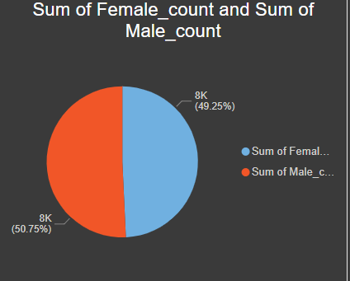
Gender
This chart shows the gender based population count for actively buying the electronics.
There is 50.75% of male and 49.25% of female are contributed.

Slide 4
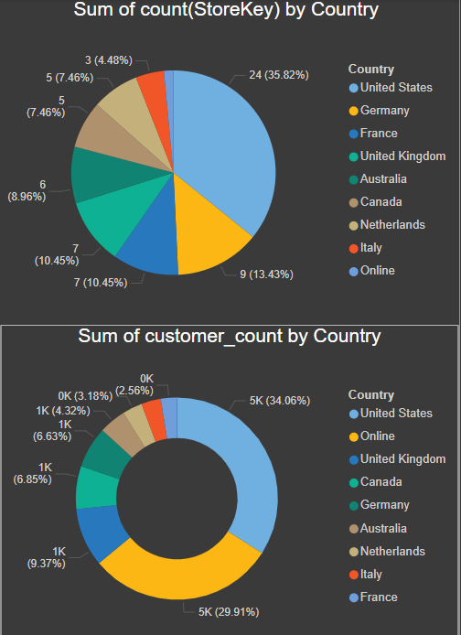
Total sales
Total 55.76 million $ overall sales this year.
Around 11,404,324 $ are on online website.
Top country is united states for having large customer and store count.

Slide 5
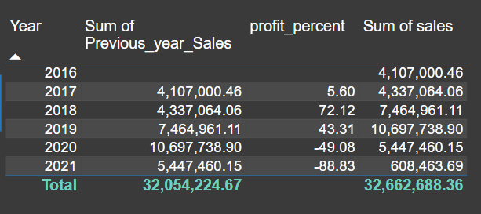
Yearwise profit
Growth and Decline: The data indicates a period of growth in sales from 2016 to 2019, peaking in 2019. After that, there is a significant decline in 2020 and 2021.
Profit Percentage Fluctuations: The profit percentages show large fluctuations. After a modest increase of 5.6% in 2017, there's a sharp rise of 72.12% in 2018 followed by a gain of 43.31% in 2019. Subsequently, there are significant declines of -49.08% in 2020 and -88.83% in 2021

Slide 6
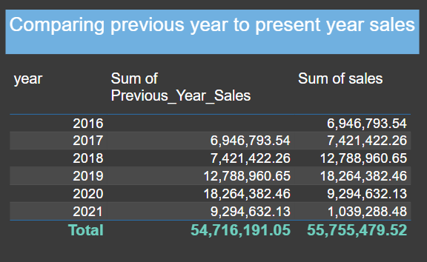
Comparing previous profit
After comparing previous year sales to present year sales its slightly better but the outcome is not expected.
To overcome follow next procedures .

Slide 7
To over come the issue
Enhance Product and Service Offerings
Product Innovation: Continuously innovate and improve your products or services based on market trends and customer feedback.
Diversification: Expand your product line to cater to a wider range of customer needs or enter new markets.
Quality Assurance: Ensure high-quality standards for your products or services to build trust and encourage repeat purchases.

Slide 8
Optimize Pricing Strategies
Competitive Pricing: Analyze competitor pricing and adjust your pricing strategy to remain competitive without compromising profitability.
Dynamic Pricing: Implement dynamic pricing models that adjust prices based on demand, customer segments, or market conditions.
Bundling and Discounts: Offer product bundles or discounts to incentivize purchases and increase average order value.

Slide 9


